Slide 1
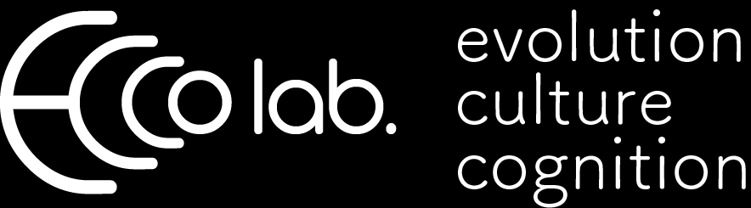
Modelling Cultural Evolutionary Dynamics of Prestige-Biased Copying
Hillary Lenfesty & Thomas Morgan
Cultural Evolution Society Annual Conference
Oct. 24, 2018
Arizona State University
Notes:
[background]

Slide 2
Who do people decide to copy?
Prestige-biased transmission:
Deferential agreement
Preferential, automatic,
unconscious copying/imitation
by lower status
Less expansive body displays
Cooperative, generous
Henrich, J., & Gil-White, F. J. (2001)
Henrich (2015)
Notes:
One of the most important questions with regards to cultural transmission is:
Who do people decide to copy?
Prestige-biased transmission has bee less studied.
This is the idea that people are prone to copying people of high social status (and this is a status which is conferred to them by the group)
copy people of high social status
Characterized by some of the following (Henrich)
Contrasted to another type of human status: Dominance (which we also observe in other animals)
→ Influence thru Coercion and threat
→ No preferential copying/mimicry, except to appease dominant
→ Expansive body displays
Aggressive, egocentric
Prestige seems uniquely human.
Conformist transmission has been widely studied,
And theoretical models suggest that conformist trans can produce and stabilize between-group diff.
However, it poses a problem for innovations; they won’t be copied if they are unpopular.

Slide 3
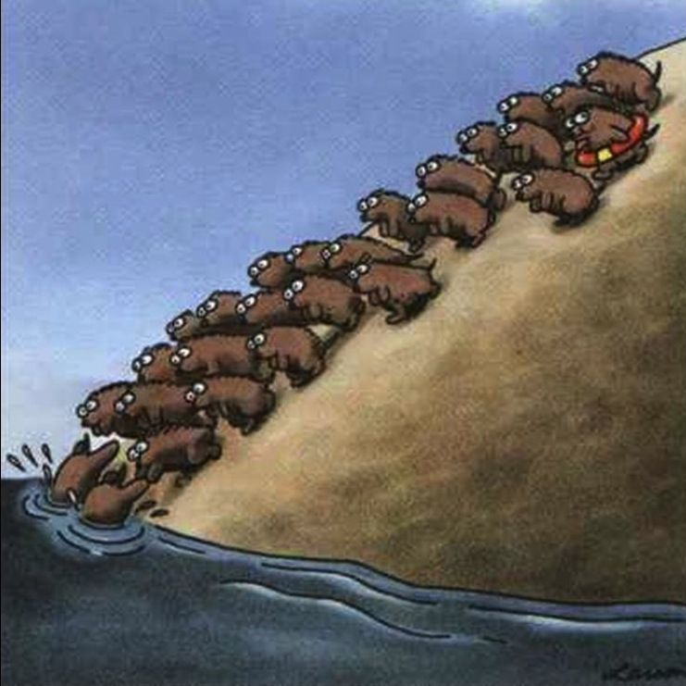
Modeling Prestige
Does prestige lead to the formation of groups?
Does prestige allow innovations to spread?
Notes:
There has been a lack of theory about effect of prestige on cult transmission, so Tom M & I decided to create an agent-based model to address 2 important questions:
Does Prestige lead to the formation of groups?
Does Prestige allow innovations to spread?

Slide 4
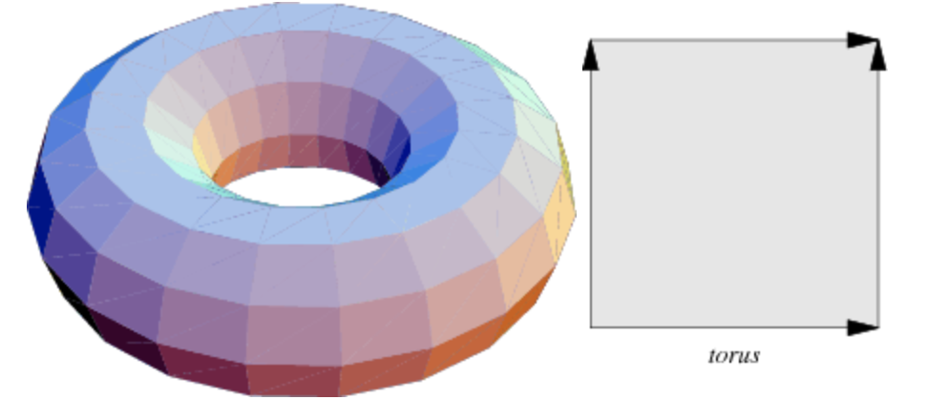
Modeling Prestige
Agents arranged randomly on a torus (“donut” world) and do not move
Initialized with unique beliefs
“Prestige”: N_{copied} by others
Agents begin with equal prestige
Agents update beliefs based on probabilistic copying rule (influence decays overs distance):
prestige = N_{copied}^{exponent}
probability ∝ prestige x e^{-3d}
Innovation rates vary
Notes:
Explain Parameters
“Agents update beliefs”
3 options:
Change belief to a new belief
Keep same belief (can copy yourself)
Innovate with an entirely new belief
Exponents:
^0 = 1, purely probabilistic copying by distance rule
^1 = N copies, no extra prestige influence

Slide 5
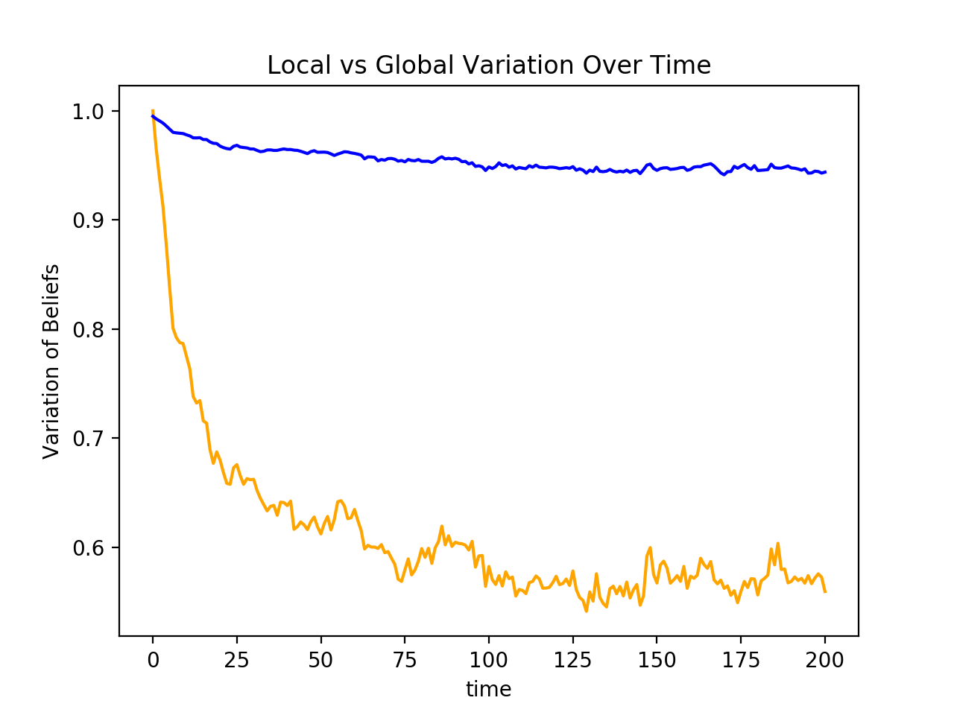
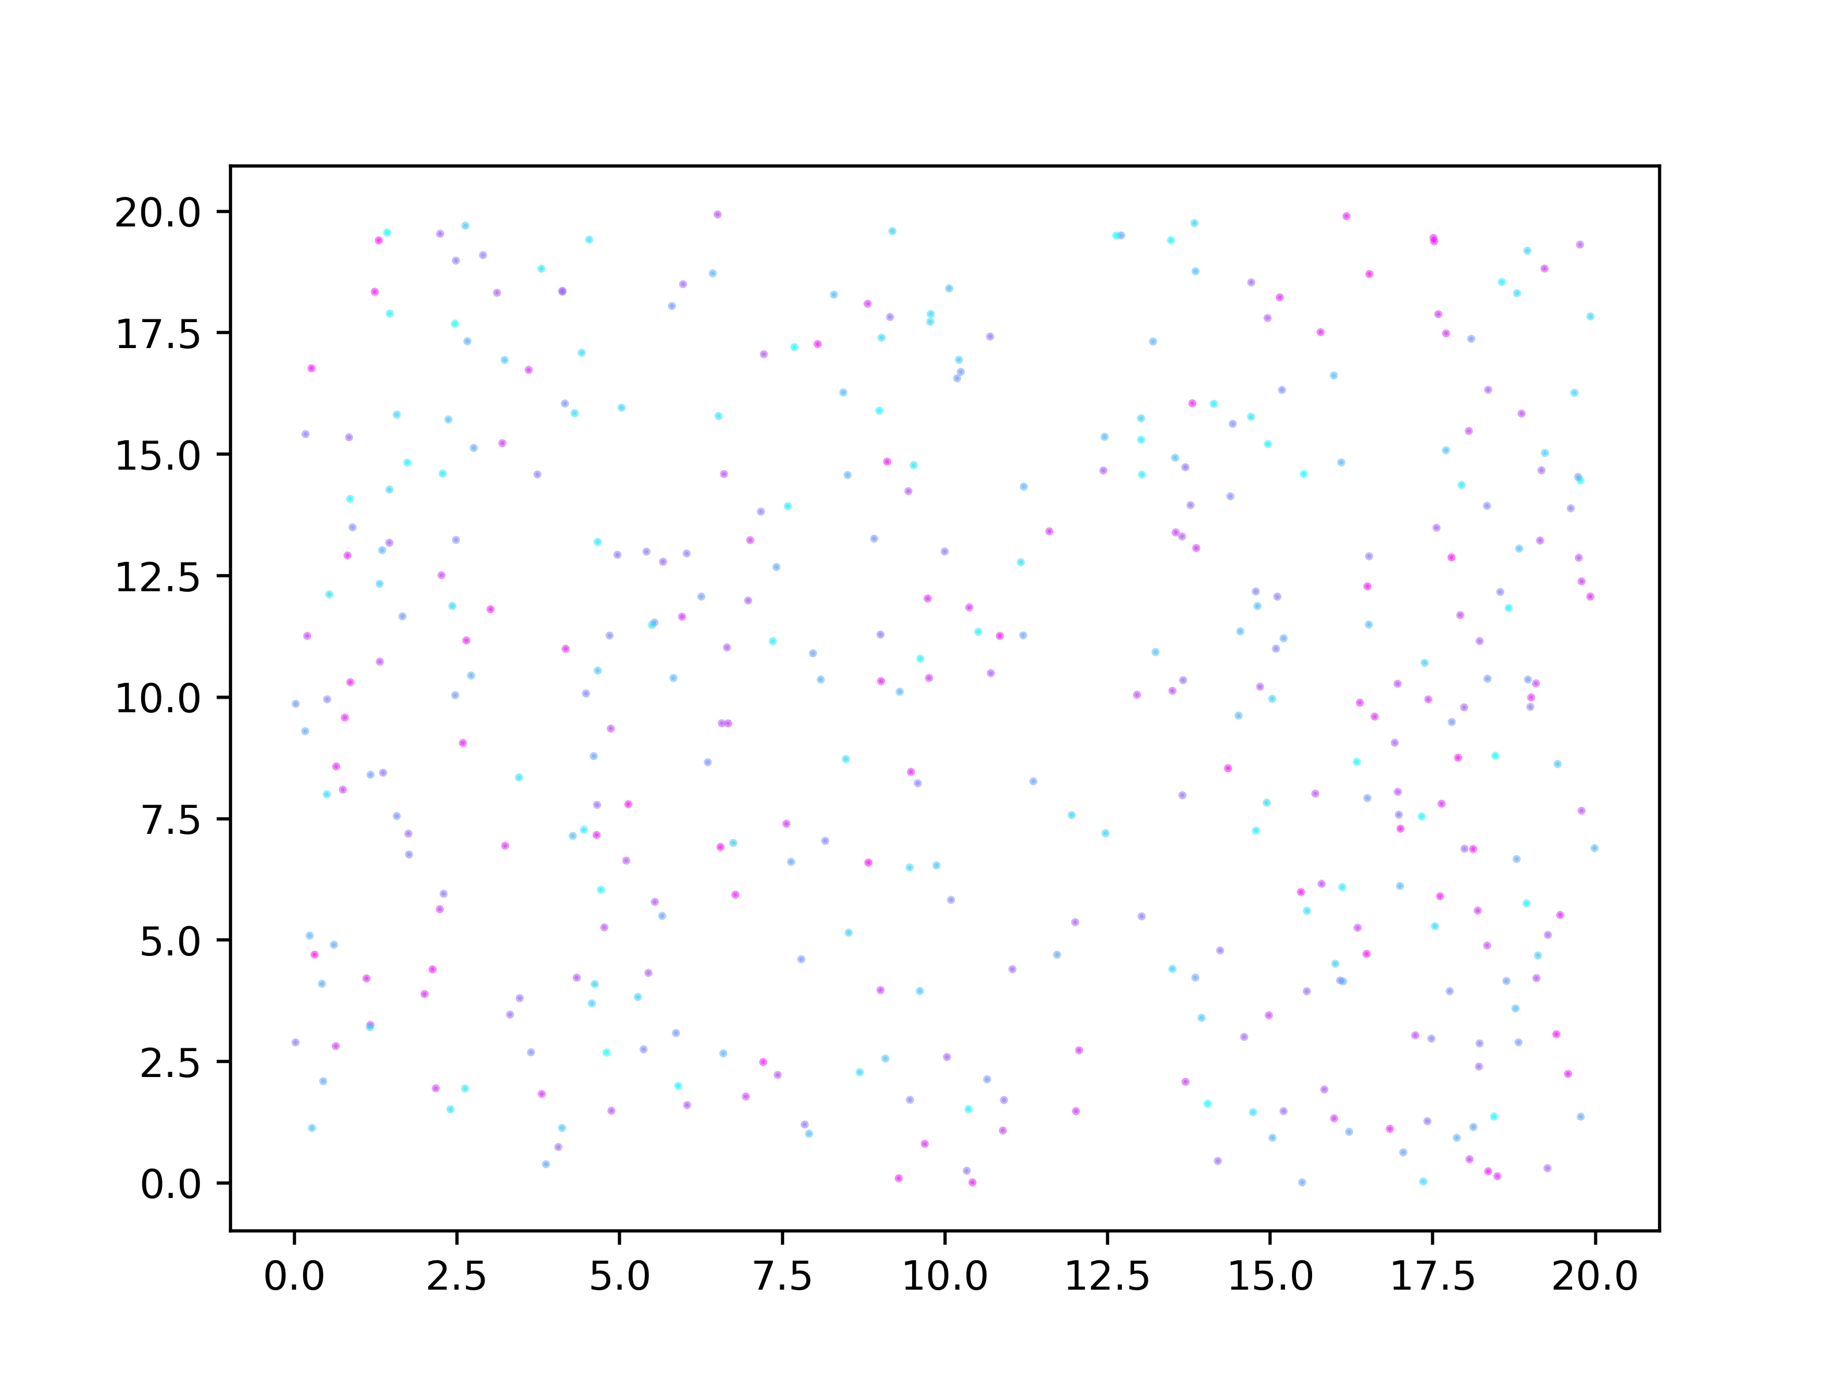
“Random” population structure
Innovation Rate = .001
Prestige = N_{copied}¹
n Agents = 400
Notes:
N=400 to demonstrate larger sub-groups;
Watch people at the boundaries changing their beliefs
Global is blue
Local is orange
Explain that circle size is prestige and
Colors are beliefs

Slide 6
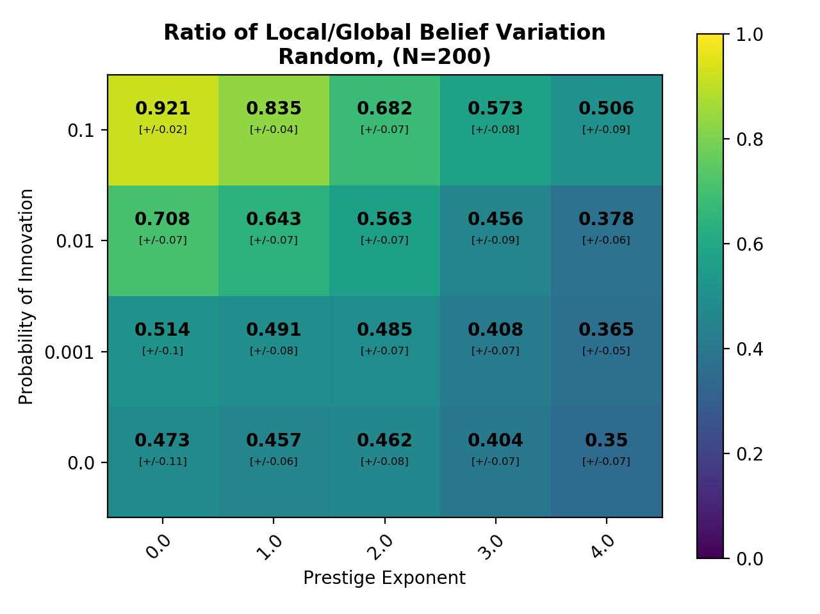
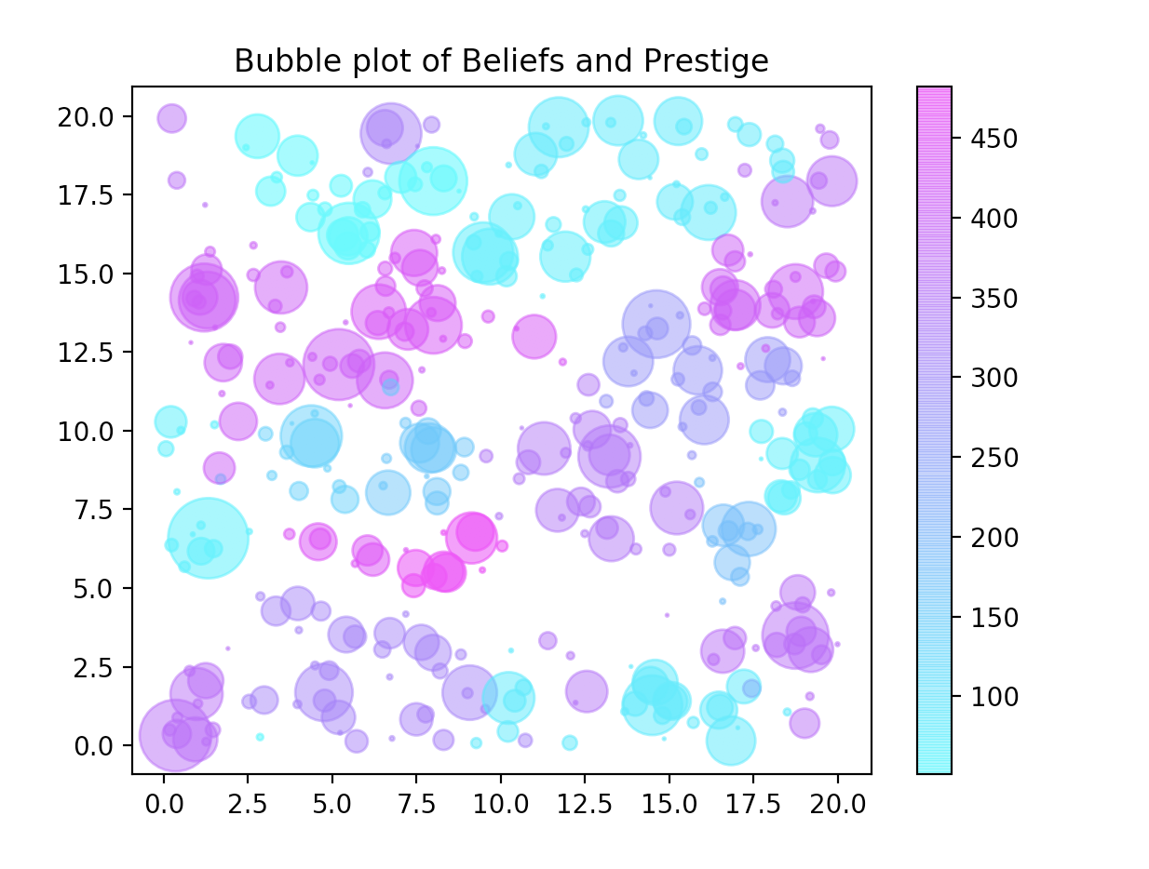
Group formation
Notes:
If we look at the ratio of local/global variation across all parameters in a randomly-connected population, we see now where we can expect cultural groups to start to form. The animation I previously showed you was here (red arrows). So pretty much under all of these other conditions we can see groups forming as we add in Prestige: the ratio decreases (not so much in the upper LH corner: recall that was the first anmation where beliefs were constantly changing).

Slide 7
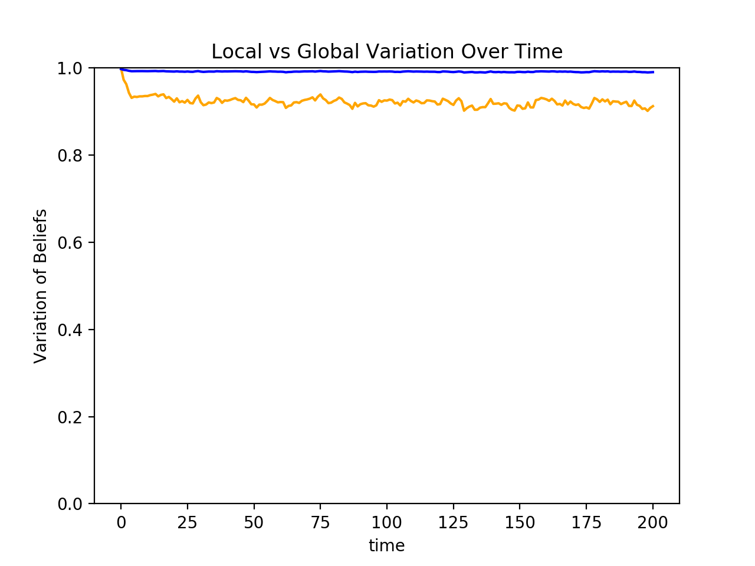
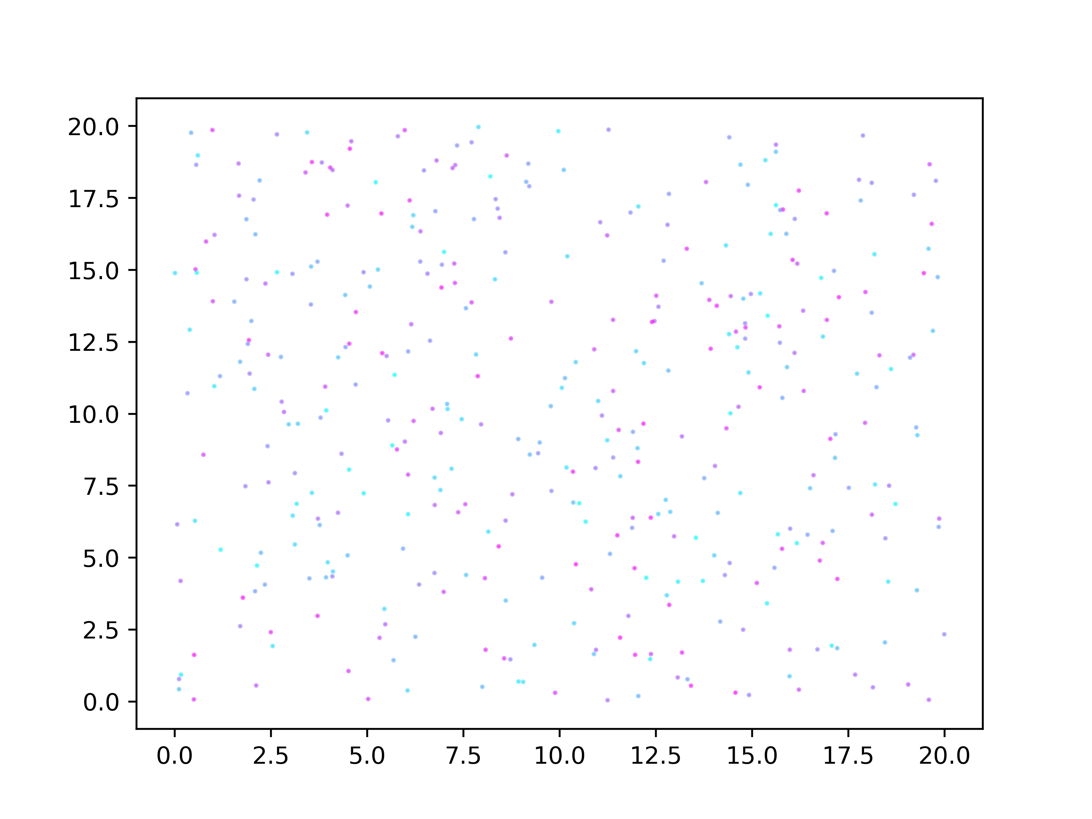
Innovation Without Prestige:
Innovation = .1
Prestige = N_{copied}⁰
n Agents = 400
Notes:
Almost no group variation as innovations are happening to frequently and the world is constantly changing.

Slide 8
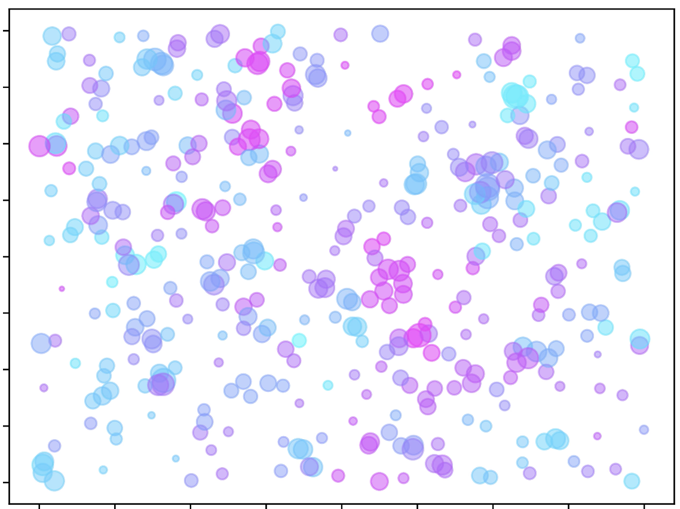
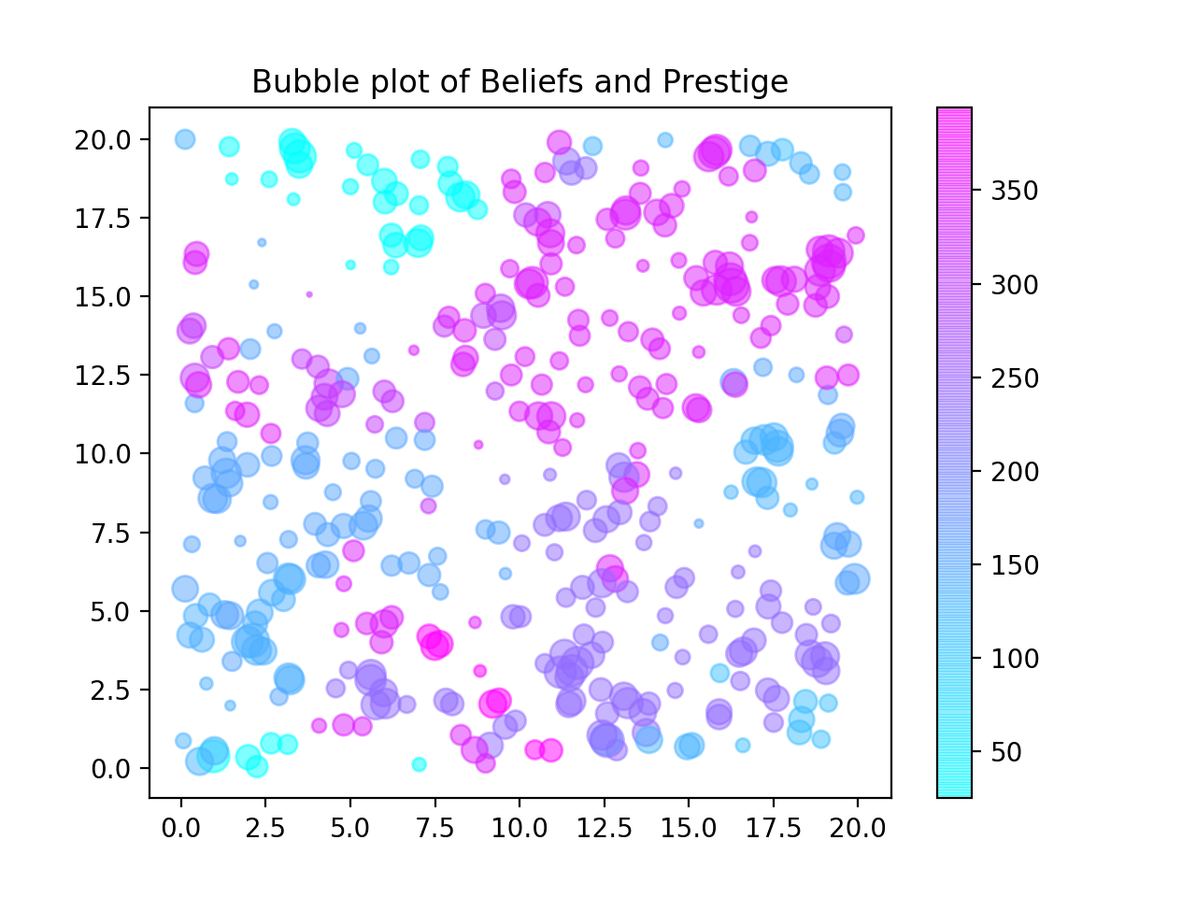
Group formation
Notes:
If we look at the ratio of local/global variation across all parameters in a randomly-connected population, we see now where we can expect cultural groups to start to form. The animation I previously showed you was here (red arrows). So pretty much under all of these other conditions we can see groups forming as we add in Prestige: the ratio decreases (not so much in the upper LH corner: recall that was the first anmation where beliefs were constantly changing).

Slide 9
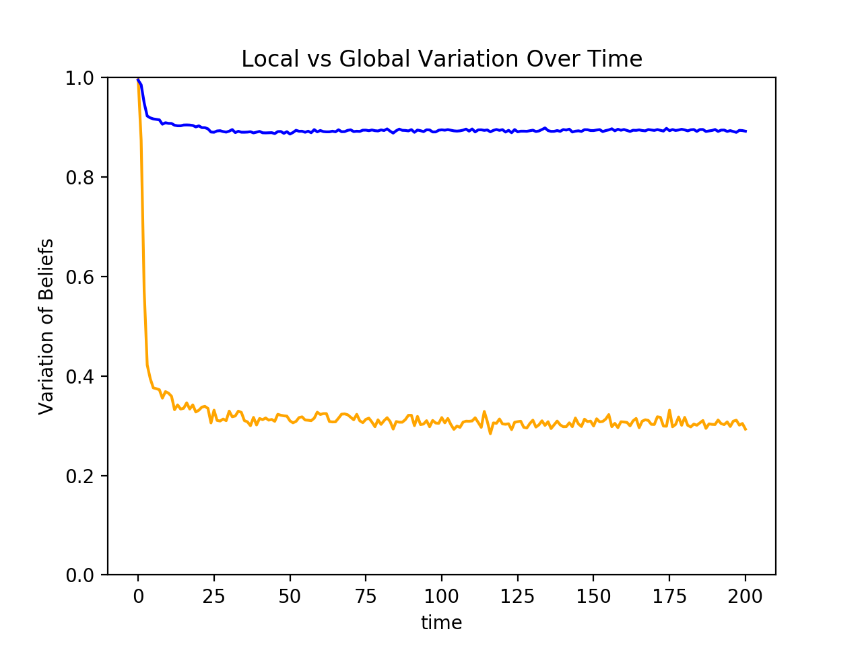
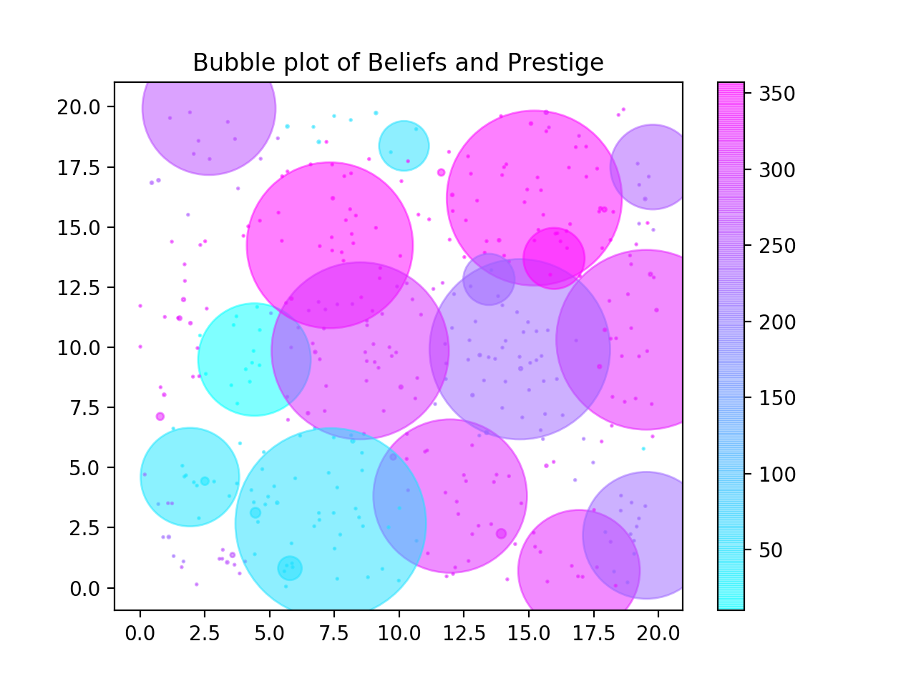
Strong Prestige-bias without Innovation
Innovation Rate = 0
Prestige = N_{copied}⁴
n Agents = 200

Slide 10
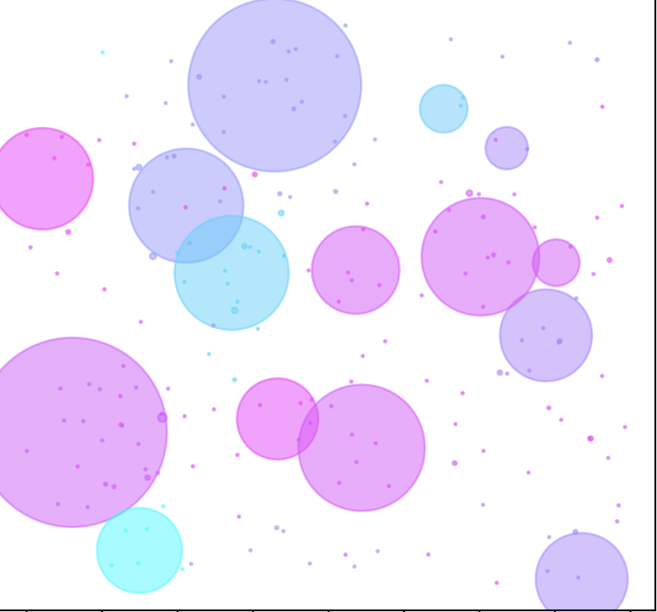
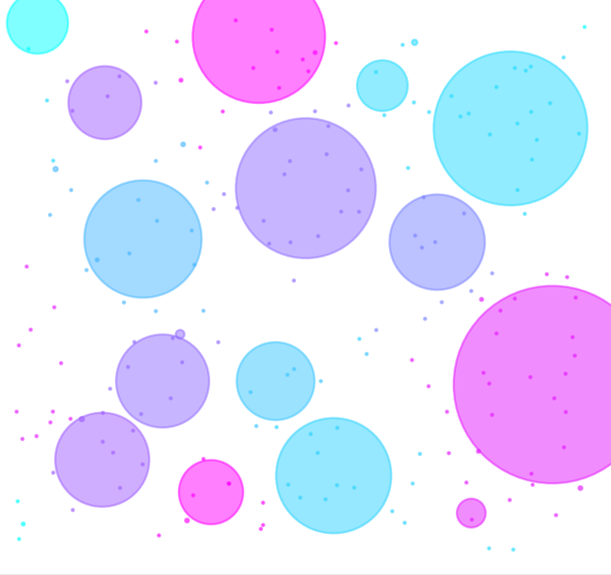
Group formation
Notes:
If we look at the ratio of local/global variation across all parameters in a randomly-connected population, we see now where we can expect cultural groups to start to form. The animation I previously showed you was here (red arrows). So pretty much under all of these other conditions we can see groups forming as we add in Prestige: the ratio decreases (not so much in the upper LH corner: recall that was the first anmation where beliefs were constantly changing).
When prestige is amplified and innovation is present, groups will form and innovations will spread but they will most likely be spread by a prestigious person who innovates, or a prestigious person who adopts someone else’s innovation.

Slide 11
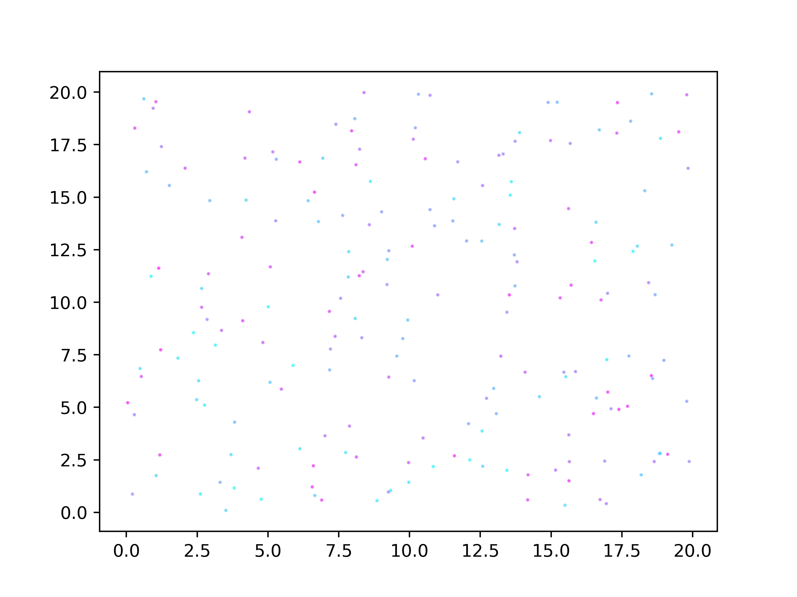
Strong Prestige with Frequent Innovation
Innovation Rate = .1
Prestige = N_{copied}⁴
n Agents = 200

Slide 12
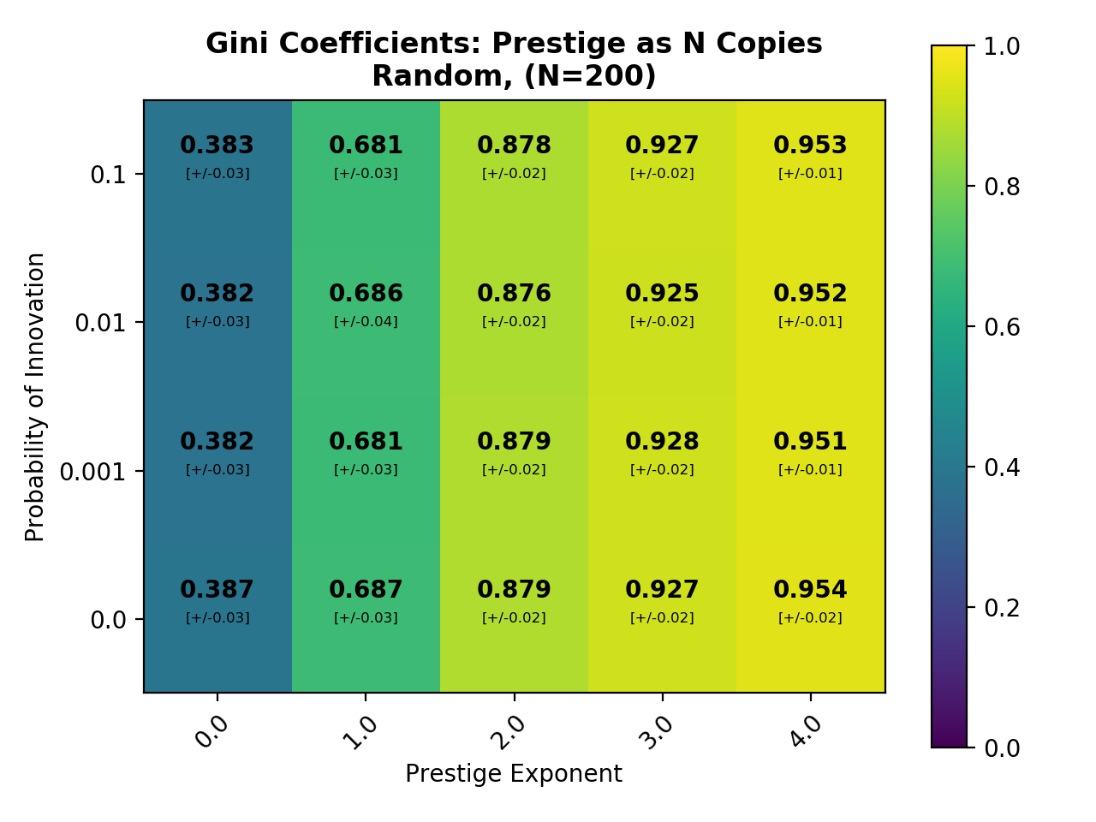
Max Inequality
Perfect Equality
Notes:
Gini coefficient is generally a measure of economic inequality, but here we can use it to represent number of copies or prestige: we see that the higher the Gini value, the more disproportionately prestige is distributed in a population.
“Council of Elders” in the 2nd/3rd column
“Big Man” Socieities” in the last 2 columns, w single individuals carrying most of the prestige (capital)

Slide 13
Summary
Does prestige lead to the formation of groups?
→ Yes
Does prestige allow innovations to spread?
→ Yes, but it depends on who is innovating
To Do:
Add memory decay
Notes:
Does prestige allow innovations to spread?
Innovatons will be spread by prestigious people who innovate, or prestigious ppl who pick up the innovations.
Look at belief history to find out how many ppl believed in the belief innovated by what kind of person.

Slide 14
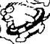
Thanks

